Slide 1
Where does energy come from?
Notes:
Teacher’s notes
Key questions
Can you describe the different types of energy production?
Can you give examples of each?

Slide 2
Why does every drop count?
Discuss
What do you think is a good definition of
energy conservation?

Slide 3
Saving energy
Choose two images:
Write a comment for each image.
One comment describing wasting energy.
One comment describing conserving energy.
Share your work with the class.
Notes:
Teacher’s notes
Display or distribute the images on the next slide.

Slide 4
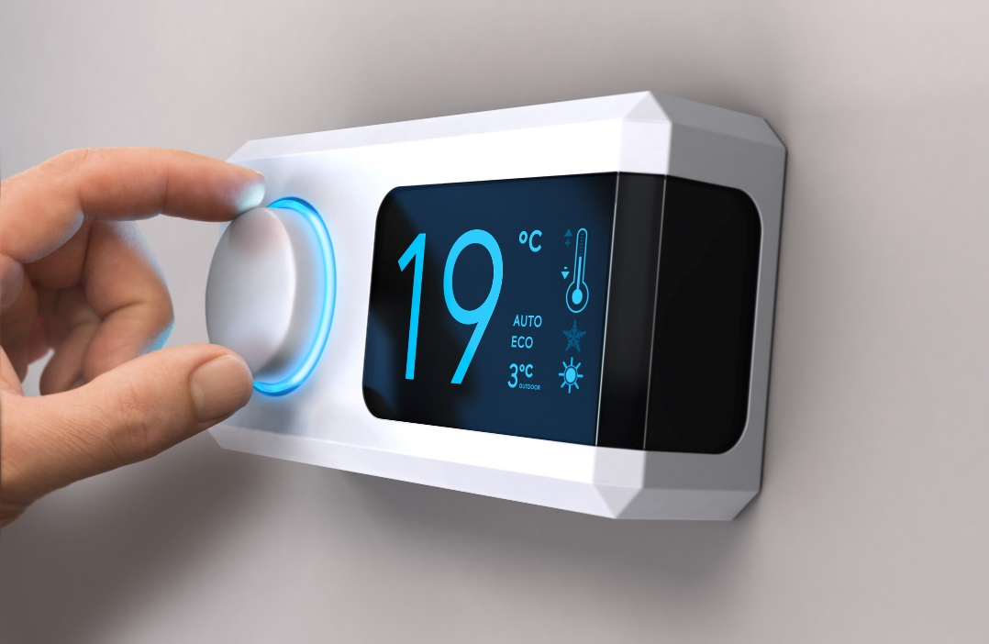
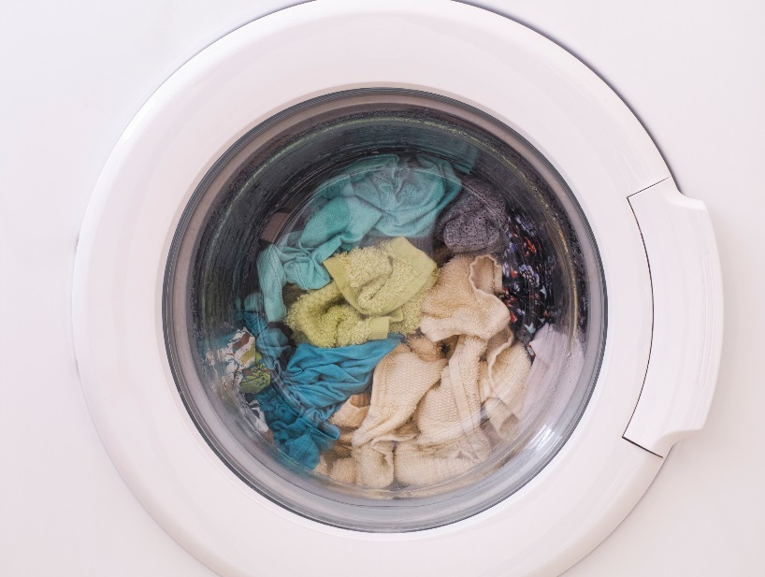
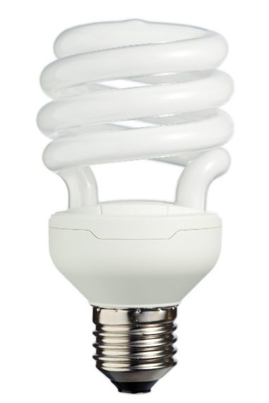
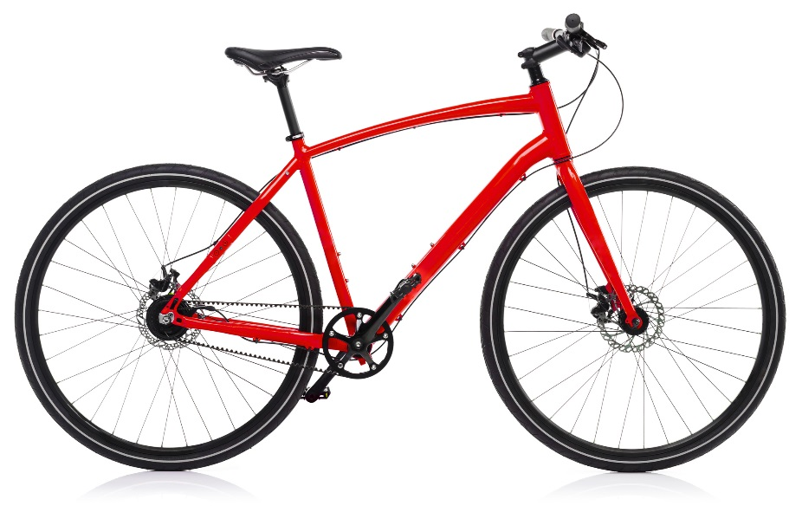

Slide 5
Where do we use energy at home?
Make a list that shows:
Direct energy use and indirect energy use.
Notes:
Teacher’s notes
Think about direct energy use.
Working in small groups make lists of:
things that you plug in (e.g. phone chargers, computers, televisions, MP3 players);
things that use batteries (e.g. remote controlled toys, portable radios);
things that you switch on (e.g. lights, a heater, central heating);
things that burn (e.g. a gas cooker, a solid fuel fire, oil-fired heating)
Think about where you use energy indirectly at home, add these to your list.
How do you use water without realising it? (For example, energy is needed to filter tap water and to package and transport food).

Slide 6
Where do we waste energy at home?
Look at your list and mark any instances where you might be wasting energy.
Notes:
Teacher’s notes
Prompt questions:
Do you leave electrical devices turned on when no-one is using them?
Do you use old-fashioned light bulbs instead of energy saving ones?
Do you leave devices on standby when they could be turned off?
Do you heat spaces more than necessary (e.g. leaving radiators on at full heat in spare rooms)?
Do you heat more water than they need (e.g. over-filling kettles and saucepans)?
Does energy 'escape'? Do you have open windows when the heating is on?
Is the house draughty? Do you leave the fridge door open for ages when choosing a snack?

Slide 7
Saving energy
Notes:
Teacher’s notes
Ask pupils to review their saving and wasting energy lists after watching the animation.
Discuss how they and family members can save energy at home.

Slide 8
What is a carbon footprint?
A way to measure the combination of things that someone needs, uses and does is to sum up all of the energy used. This total is an estimate of how much energy needed to grow, make and transport all of the things a single person or business consumes. This total is called a carbon footprint.
It's called a carbon footprint because all energy use involves the chemical element carbon. Reactions involving carbon provide energy. This is what happens when heat is produced to do work, for example by burning fuel in a car engine, or by using electrical energy to power a heater. The footprint part of the term refers to the trace left on the world by the use of the carbon: as if by using the energy you leave behind carbon in the form of Carbon Dioxide gas, which is one of the products of burning fuels

Slide 9
Greenhouse gases and climate change
Carbon Dioxide is a greenhouse gas, and the release of it into the atmosphere of earth causes an insulating effect so that radiation from the sun gets trapped in the atmosphere and leads to climate change.
Climate change is causing changes in weather patterns, and it is predicted that if emissions of greenhouse gases are not reduced, climate change will speed up. This could cause more flooding, droughts, formation of deserts, famine, water shortages and cause sea levels to rise flooding coastal cities.

Slide 10
Carbon emissions
We can all contribute to reducing carbon dioxide emissions by reducing energy use. Investigate these terms about carbon and use them to guide your thinking in the activities that follow.
Carbon
Desertification
Causes of famine
Carbon dioxide
Climate change
Combustion
Greenhouse effect

Slide 11
The carbon cycle
The carbon cycle describes the way carbon moves through the environment. It is important because carbon is the basis of all life on earth.
Can you list the steps in the carbon cycle?

Slide 12
The carbon cycle
Next, investigate these terms and use what you find out to guide your thinking in the activities that follow:
Carbon cycle
Photosynthesis
Respiration
Decay
Energy
Reaction
Fossil Fuel

Slide 13
The carbon cycle
Based on your research suggest some reasons why:
The reported decline in the populations of wild bees might become a long-term problem.
Becoming a vegetarian might be a way to help in reducing energy consumption.
Reduction in the area covered by permafrost in the arctic regions of Canada, Russia, Norway, Finland and Greenland could add to the amount of greenhouse gasses in the Earth's atmosphere.

Slide 14
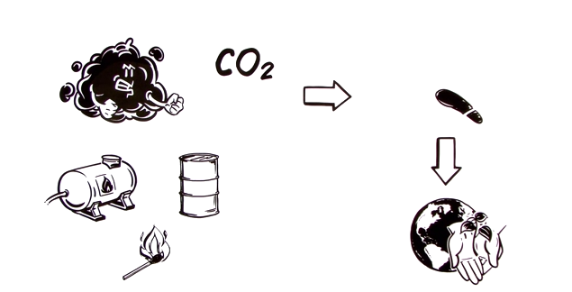
My carbon footprint
Watch this short animation to get a sense of what the issues are.
This video is sourced from the Wikipedia page about Carbon Footprint
Notes:
Teacher’s notes
This video is linked to the Wikipedia page about Carbon footprint.
Link to the page, where the video is displayed
https://en.wikipedia.org/wiki/Carbon_footprint
Direct link to the video
https://upload.wikimedia.org/wikipedia/commons/transcoded/7/79/Carbon_Footprint_simple-explanation_EN.webm/Carbon_Footprint_simple-explanation_EN.webm.360p.webm

Slide 15
My carbon footprint
Next, make a diagram of the web of interconnections that link you to where the things you use, the places you go, and the things you do, all include energy use. This will give you a sense of how complicated your Carbon Footprint is.
Take a look at the example below to get started.
My carbon footprint example
Notes:
Teacher’s notes
Instructions for making 'My Carbon Footprint' diagram:
1. Put the title: 'My Caron Footprint' in the middle of a big sheet of paper.
2. Around this draw bubbles – for example: food, clothing, travel, heating, leisure and society. (Slides 16 – 20 include prompts for each category)
3. Draw more bubbles that branch off from the examples mentioned in point 2. In these bubbles break down what's involved in making or using the products or events that you list. Try to have at least three bubbles in your branches. Too few and your diagram will be incomplete, too many and you'll run out of room; so pick examples that you think are closest to what you do.
4. As you branch off bubbles you'll see that you end up with layers of bubbles that surround your diagram. As you keep branching outwards, notice that your list starts to mention what things are made of like metal, plastic, bricks, tarmac, fabric, and things like fuel: oil, petrol, diesel, gas, electricity. If you were to keep going outwards many of the outer layer of bubbles would end up being about plants and how they make food for us or for the animals we eat, and trapped the energy of sunlight that eventually became fossil fuels.

Slide 16
My carbon footprint: food
When drawing the bubbles that that link from Food ask yourself questions about where the ingredients come from and how they get to your table.
Think about all the things that you eat and drink in a typical week, pick several that you eat often and write the name of the food item in a new bubble branching off from the 'food' category. For example:
What do I eat?
Where does it come from?

Slide 17
My carbon footprint: clothing
When drawing the bubbles that link from Clothing, ask yourself what materials and fabrics your clothes are made from.
Think about how synthetic fabrics are made and what are the raw materials used to make them. Think about natural fibres like wool and cotton and the processes used to make these into textiles. Here are two questions to get you thinking:
What do I wear?
Where does it come from?

Slide 18
My carbon footprint: travel
For the Travel bubbles think about the places you go regularly: how do you get to school and home again? Do you visit people at the weekends? Have you been away on holiday?
Choose the transport you use regularly like bus, car, train or bicycle. Add the fuel used to make the car go, you can also branch your bubbles out to another layer and make a note of the materials used to make the car or bike.

Slide 19
My carbon footprint: heating
When drawing the bubbles that link from Heating, ask yourself:
When/Where am I indoors?
How is the building kept warm?

Slide 20
My carbon footprint: leisure
Like travel, there may be times when you go somewhere to do an activity: such as go to the cinema or visit friends.
List some of your favourite pastimes and add bubbles to list the materials or energy used to make them happen.

Slide 21
My carbon footprint: society
The last category is a bit harder to estimate. There are all sorts of things and people around you that have an energy cost.
For example, your household bins get emptied and it needs a bin lorry to drive round and collect it. You might never have needed it, but your local hospital is there when you do, and it takes energy for it to run.

Slide 22
My carbon footprint diagram
Display your diagrams and see how each of us is connected to all sorts of
far-away places and many forms of indirect use of energy to make goods and transport them to us.
In many cases if you know about this web of connections you can choose to do and use things that are either more or less energy intensive and therefore have a bigger or smaller impact on your carbon footprint.
Remember! The main ways that you can help to reduce your personal carbon footprint are by following the principles of reduce, reuse and recycle. Learn more about the Three R’s at Ecoworld.org.uk
Notes:
Teacher’s notes
The Ecoworld website includes several animations and activities covering the topic of the reduce, reuse and recycle.

Slide 23
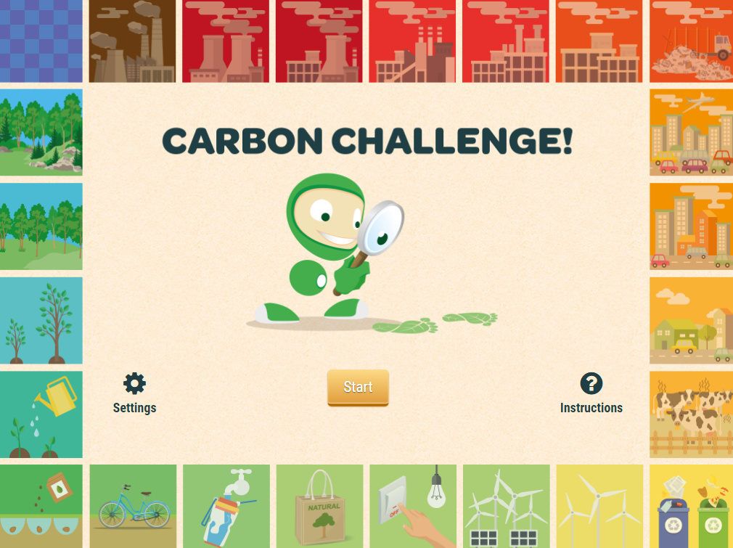
Carbon challenge
Play the carbon challenge

Slide 24
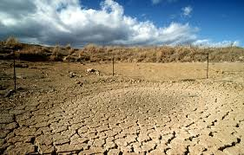
Time machine
Tell this story as if you were a journalist in the future.
Did they really not organise to stop the causes of climate change until the Mediterranean dried up?
Notes:
Teacher’s notes
Use this writing prompt to create ideas about imagined experiences from the future.
Ask pupils to think about what could happen in the future if climate change were to rise above 2ºC. For example, the Mediterranean is a shallow sea and like the former Aral sea in Kazakhstan and Uzbekistan, it could be at risk of vanishing if global warming were to accelerate.
Ask pupils to imagine being in the far future, when there has been hundreds of years of drought, desertification, and food shortages. What would someone from the future think about us today if we fail to control climate change?

Slide 25
Saving energy
Learn more at ecoworld.org.uk

