Slide 1
Why does every drop count?
Notes:
Teacher’s notes
Key questions
Why can’t we drink sea water? Where we might find fresh water? Why do we need to save water?

Slide 2
Why does every drop count?
New words and phrases
Water conservation
Glacier
Salt water
Notes:
Teacher’s notes
You may find it useful to introduce pupils to new words and phrases. The amount of detail you use when explaining these terms will depend on the age and prior knowledge of the children.
Pupils may find it useful to complete a concept map for each new word and phrase. Please see the next slide.

Slide 3
New words and phrases concept map
Name:
Definition
Word
In my own words
Example
Example
Non example
I will remember this word by connecting it with:
Notes:
Teacher’s notes
Pupils may find it useful to complete a concept map for each new word and phrase.

Slide 4
Saving water

Slide 5
Saving water
New words and phrases
Efficient water use
Water hippo
Toilet cistern
Tap aerators
Water-saving showerhead
Power shower
Sprinklers
Notes:
Teacher’s notes
You may find it useful to introduce pupils to new words and phrases. The amount of detail you use when explaining these terms will depend on the age and prior knowledge of the children.
Pupils may find it useful to complete a concept map for each new word and phrase. Please see the next slide.

Slide 6
New words and phrases concept map
Name:
Definition
Word
In my own words
Example
Example
Non example
I will remember this word by connecting it with:
Notes:
Teacher’s notes
Pupils may find it useful to complete a concept map for each new word and phrase.

Slide 7
Water Detectives
Play water detectives

Slide 8
Using water at home
Your task is to carry out a survey of where water is used in your home. Can you:
Draw a birds eye view of the main rooms in your house.
Add a symbol to show each place where water is used.
At home count the number of water sources in each room.
Calculate the total number of water sources.
Can you estimate where water is used most frequently in your house?
Notes:
Teacher’s notes
New words and phrases: Birds eye view, water source.
Invite pupils to present the results of their surveys to the rest of the class.
Discuss which rooms have the highest number of water sources.
Discuss where water is used most frequently in the home.
The bathroom is where most water is used.
This is a result of showering and or bathing, toilet flushing, brushing teeth, washing in the basin.
Showers account for the biggest water use in the home (25%) followed by lavatories (22%).

Slide 9
Water use at school
Think about the sources of water in your school.
Are there any sources of water found at home and school?
Are there any sources of water found only in school?

Slide 10
Water use at school
Your task is to carry out a survey of where water is used in your school. Can you:
Design a data collection sheet to collect information from your survey.
In groups, survey the school safely and complete your data collection sheet.
Notes:
Teacher’s notes
Encourage pupils to use ICT to enter and present their results in an appropriate format.

Slide 11
Water use at school
What does your survey tell you?
Where is water used in your school?
Can you calculate the number of water sources in each location?
Can you decide which water source is used most frequently?

Slide 12
Water use at school
Can you estimate how much water you use to:
Flush the toilet
Wash your hands
Get a drink at the water fountain
Notes:
Teacher’s notes
Encourage pupils’ to use mathematical resources to estimate the water usage. Display or distribute a copy of How much water do we use? (next slide). Use this to reflect on the accuracy of each pupil’s estimates.
Next, ask pupils to calculate how much water is used to flush the school toilets in a day, week and/or month.
Ask the class to write a summary of the school’s current water use.
Have them identify where they think water is being wasted. Ask pupils to make a list of what they could do to reduce costs. Once completed, pass on a selection of pupils’ work to the Principal for comments. Alternatively, invite the Principal to the class and allow pupils to present their findings.

Slide 13
How much water do we use?
Approximate figures:
Activity Litres
Shower 27
Power shower 80
Bath 80
Toilet flush 9
Washbasin – including hand washing and brushing teeth 4
Washing clothes by hand 15
Washing machine – per load 80
Washing dishes by hand 7.5
Washing dishes in dishwasher 30
Car wash – per bucket 7
Hosepipe – per minute 15
Garden sprinkler – per minute 9

Slide 14
Counting the cost
Debate
We would be more careful about using water if we had to pay for it.
Notes:
Teacher’s notes
Organise the class into two groups: Group A and Group B.
Explain that in this activity, the pupils will take part in a debate.
Ask Group A to work together and list arguments to support the statement.
Ask Group B to work together and list arguments that oppose the statement.
Ask them to adopt group roles: for example scribe, reporter and group leader.
Invite the two groups to take part in a debate.
Act as chairperson, or alternatively invite one child from each group to chair the debate.

Slide 15
Counting the cost
Work together and agree an appropriate price for one litre of water.
Notes:
Teacher’s notes
Divide the class into groups. Ask each group to work together and agree an appropriate price for
one litre of water. To stimulate thinking, encourage them to think about and compare the cost of:
• a litre of bottled water;
• a litre of milk;
• a litre of lemonade; and
• a litre of petrol.
Invite each group to reveal how much they think a litre of water should cost. Next, ask them to
use their water price to calculate the cost of the following activities:
• four showers;
• one bath;
• flushing the toilet ten times;
• doing two loads of washing; and
• using the dishwasher once.
Allow the pupils to use calculators. However, you may wish to set up a spreadsheet for pupils
to use.
Next, ask groups to calculate how much it would cost for a family to do these activities over a
week, a month and a year. Invite them to present their findings to the rest of the class. Initiate
a class discussion about each group’s findings. Ask the pupils if they think the proposed
costs for one litre of water are realistic.
Also ask them if they are surprised by the projected costs. Inform the class that the average household bill for water in England during 2013 was £247 (this includes both clean water and sewage treatment).
Discuss as a class if they think this is a fair amount to pay.

Slide 16
Time to vote
Do you think we should pay for water?
Do you think we would use water more responsibly if we had to pay for it?
Notes:
Teacher’s notes
Carry out two class ballots. Ask the class the questions above and ask pupils to vote yes or no.

Slide 17
Learn how to be water wise
Play water wise

Slide 18
Saving Water
What water saving tips can you remember?
Notes:
Teacher’s notes – water saving tips
Turn off the tap when you brush your teeth or whilst you soap your hands before rinsing.
Don’t run tap water to cool it down. Instead, fill a reusable bottle with drinking water and keep it in the fridge.
Don't use the toilet as a bin.
Turn taps off fully after use.
Take a shorter shower.
Don't leave the water running for rinsing dishes.
Only use the dishwasher and washing machine when you have a full load.
Attach a water butt to your drainpipe and use the water collected to water your plants, clean your car and wash your windows.
Use a watering can rather than a hosepipe.

Slide 19
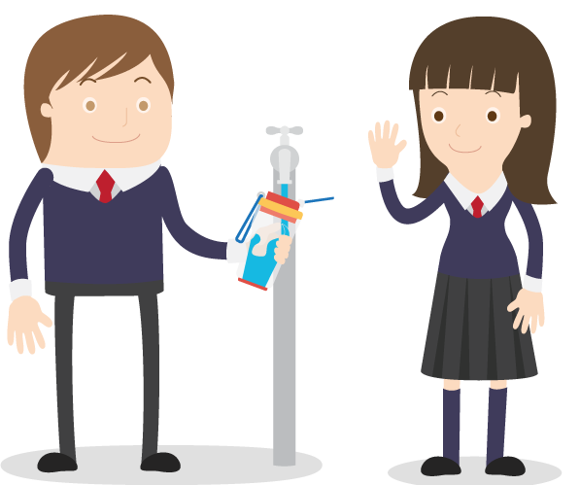
Let’s try to save our planet!
Learn more at ecoworld.org.uk

