Slide 1
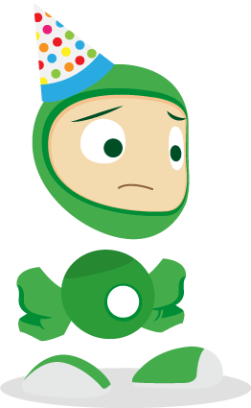

Look at all the rubbish from
Eco’s birthday party!

Slide 2

Throwing it all out won’t help our planet.
Can we recycle some of it?

Slide 3


Instead of putting it in the black bin, let’s put it in a recycling bin and it can be used to make something new.

Slide 4

Let’s look at some of the rubbish inside the black bags.

Slide 5


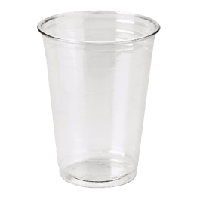
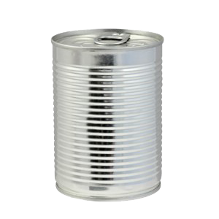
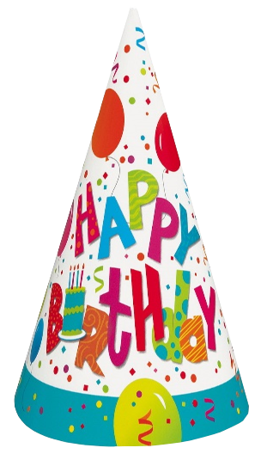
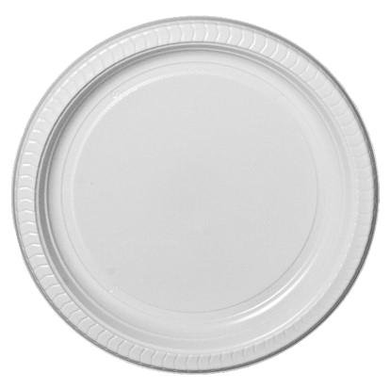
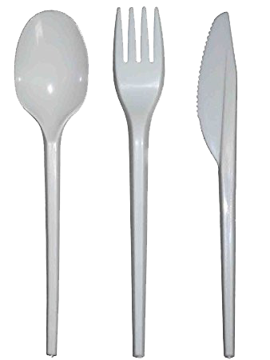
These things are made from paper,
plastic and tin.

Slide 6

We can Reduce, Reuse and Recycle them!

Slide 7

Click on the rubbish to see what we can recycle.

Slide 8

The hat is made from paper.
It can be recycled and used again!
Paper

Slide 9
The plate is made from paper.
It can be recycled and used again!
Paper

Slide 10
The cup is made from plastic.
It can be recycled and used again!
Plastic

Slide 11
The cutlery is made from plastic.
It can be recycled and used again!
Plastic

Slide 12
The food can is made from tin.
It can be recycled and used again!
Tin

Slide 13
Think about the rubbish in your black bin.
Could you recycle it instead?

Slide 14
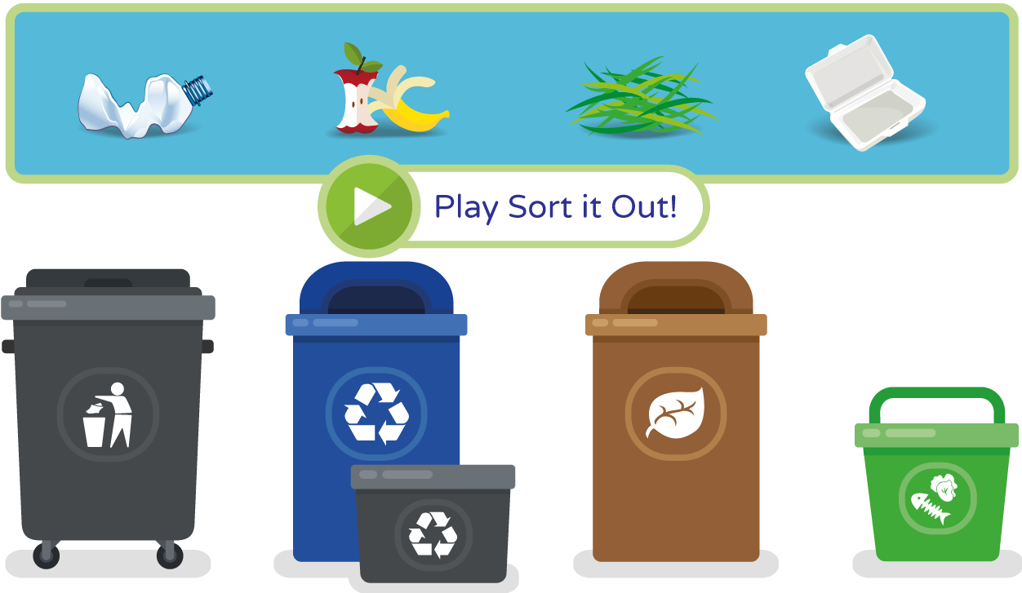
Can you help Eco sort out his recycling?

Slide 15
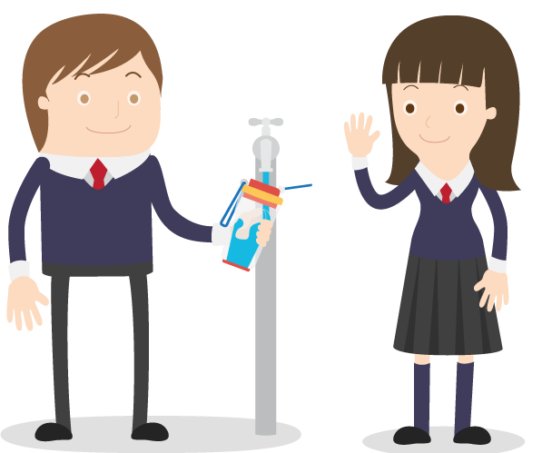
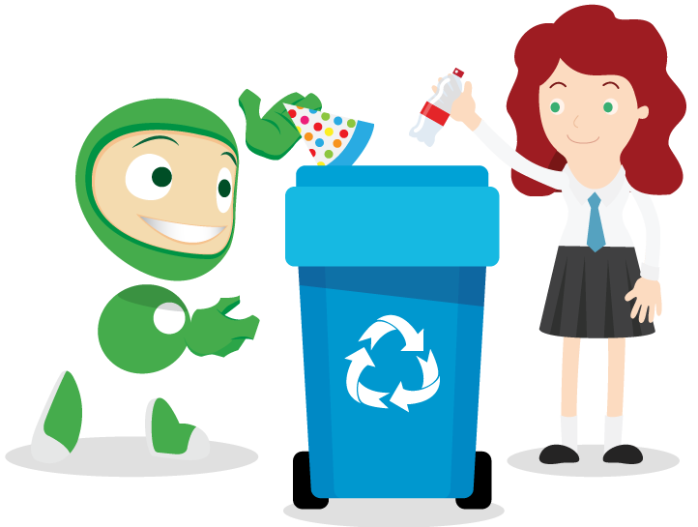
Let’s try to save our planet!
Learn more at ecoworld.org.uk

