Slide 1

The Three Rs
Notes:
Teacher’s notes
Ask pupils if they list five everyday items they can reduce, reuse and recycle?

Slide 2
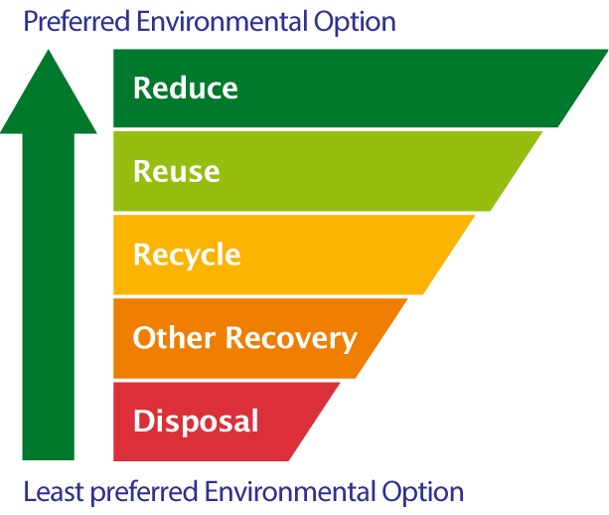
The Waste Hierarchy
The Three Rs are part of the waste hierarchy.
Can you name the Three Rs?

Slide 3
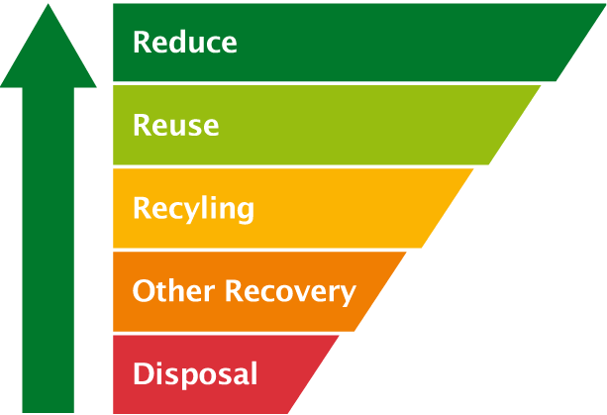
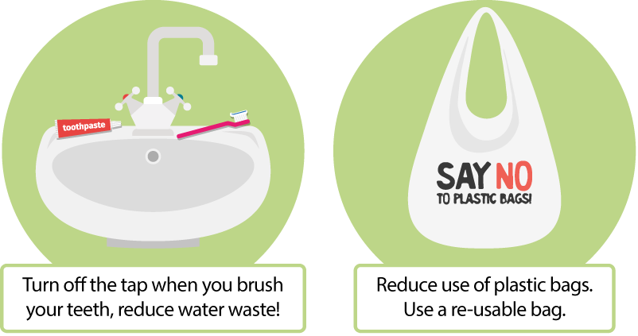
Reduce
Reduce means to use less of the things you use a lot.
Here are some ideas for ways you can reduce waste.
How can you reduce waste at home or in school this week?

Slide 4
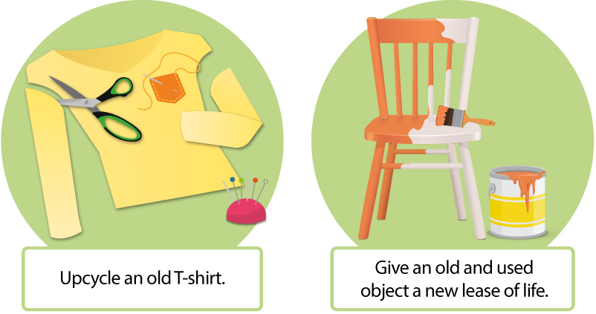
Reuse
Reuse means to use things again.
Here are some ideas for ways you can reuse waste.
How can you reuse waste items at home or in school this week?

Slide 5
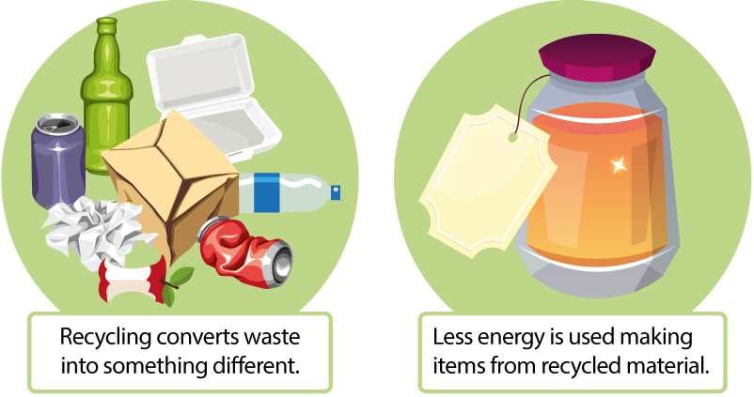
Recycle
Recycle means to make new items from old ones.
Here are some ideas for items you can recycle.
What items can you recycle at home or in school this week?

Slide 6
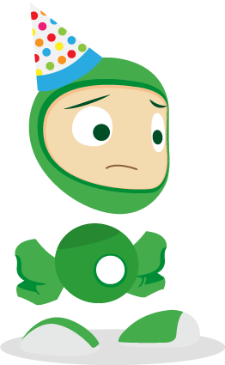

Look at all the rubbish from
Eco’s birthday party!

Slide 7
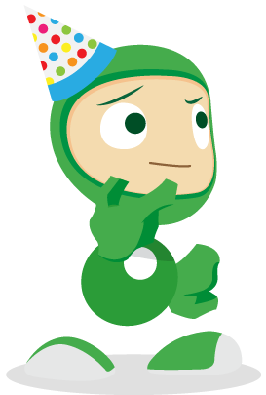
Throwing it all out won’t help our planet.
Can we recycle some of it?

Slide 8


Instead of putting it in the black bin, let’s put it in a recycling bin and it can be used to make something new.

Slide 9
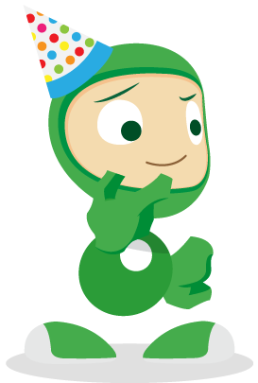
Let’s look at some of the rubbish inside the black bags.

Slide 10


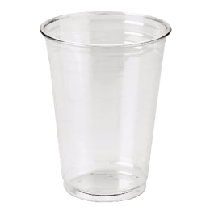
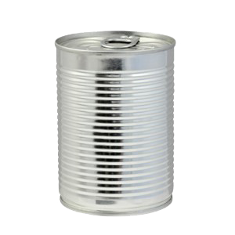
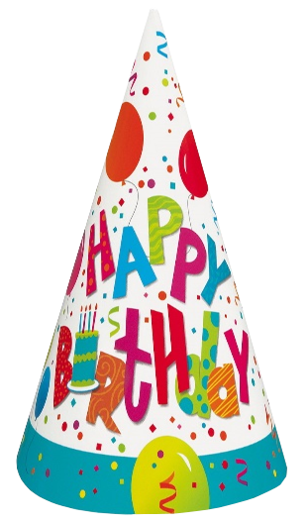

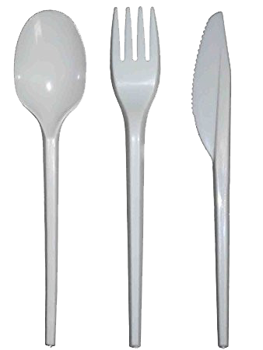
These things are made from paper,
plastic and tin.

Slide 11
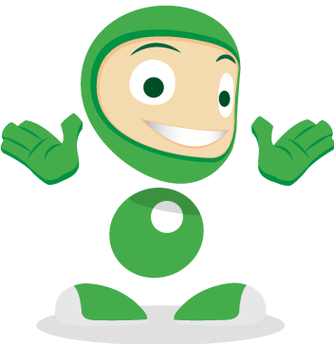
We can Reduce, Reuse and Recycle them!

Slide 12

Click on the rubbish to see what we can recycle.

Slide 13

The hat is made from paper.
It can be recycled and used again!
Paper

Slide 14
The plate is made from paper.
It can be recycled and used again!
Paper

Slide 15
The cup is made from plastic.
It can be recycled and used again!
Plastic

Slide 16
The cutlery is made from plastic.
It can be recycled and used again!
Plastic

Slide 17
The food can is made from tin.
It can be recycled and used again!
Tin

Slide 18
Think about the rubbish in your black bin.
Could you recycle it instead?

Slide 19
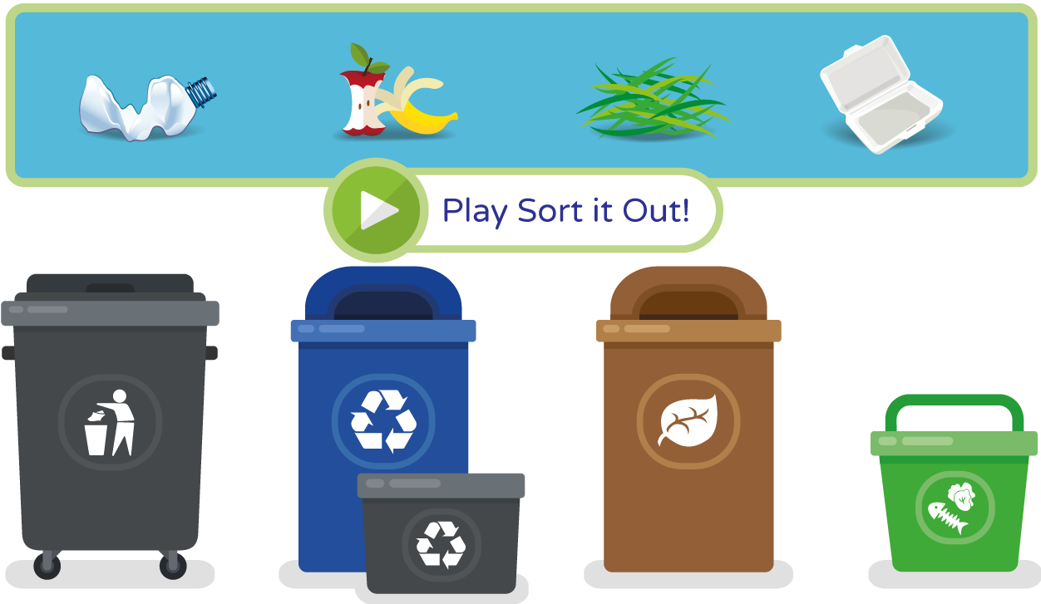
Can you help Eco sort out his recycling?

Slide 20
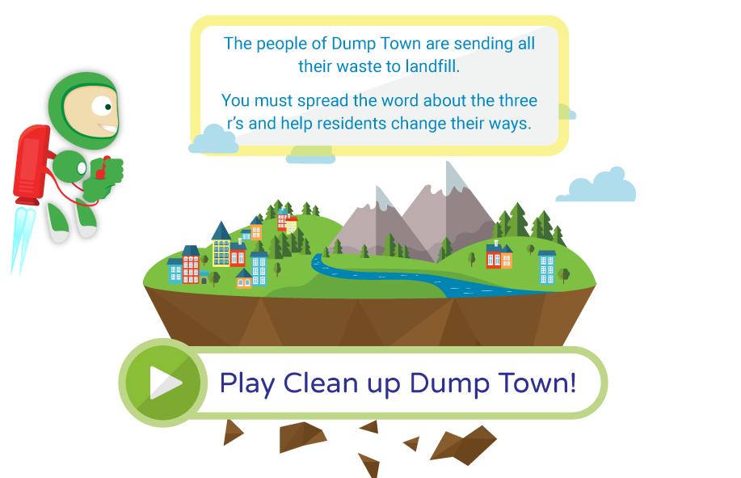
Help Dump Town clean up its act!

Slide 21
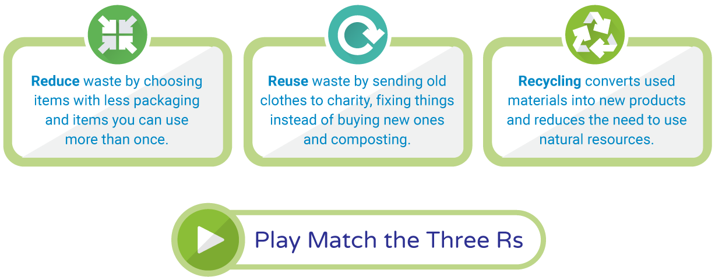
Can you choose the correct Reduce, Reuse or Recycle action?

Slide 22
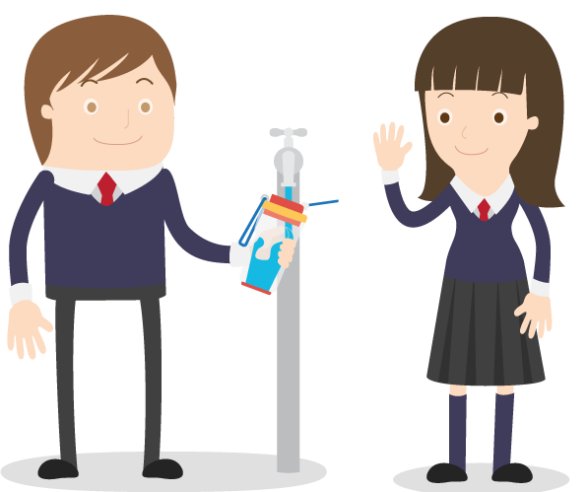
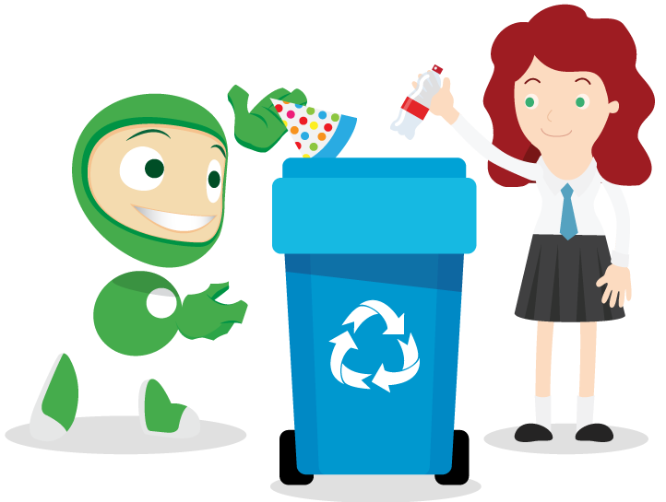
Let’s try to save our planet!
Learn more at ecoworld.org.uk

