Slide 1

Why does every drop count?
Notes:
Teacher’s notes
Key questions
Why can’t we drink sea water?
Where we might find fresh water?
Why do we need to save water?

Slide 2
Why does every drop count?
New words and phrases
Water conservation
Glacier
Salt water

Slide 3

Saving water

Slide 4
Saving water
New words and phrases
Efficient water use
Water hippo
Toilet cistern
Tap aerators
Water-saving showerhead
Power shower
Sprinklers

Slide 5
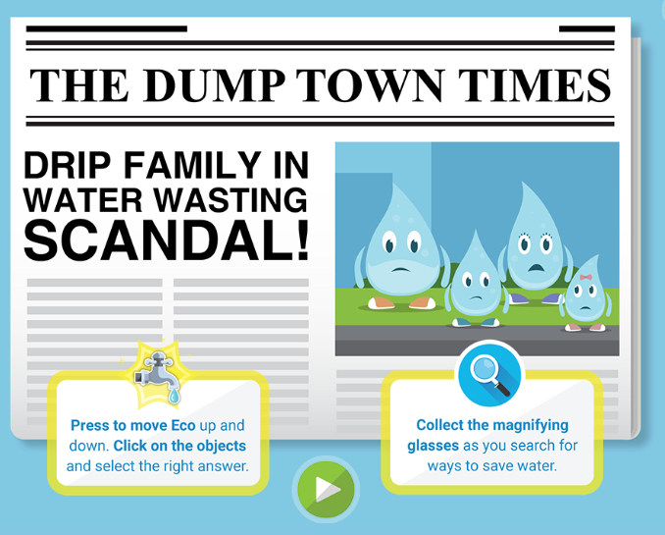

Water Detectives
Play water detectives

Slide 6
Using water at home
Your task is to carry out a survey of where water is used in your home. Can you:
Draw a birds eye view of the main rooms in your house.
Add a symbol to show each place where water is used.
At home count the number of water sources in each room. Calculate the total number of water sources.
Can you estimate where water is used most in your house?
Notes:
Teacher’s notes
New words and phrases: Birds eye view, water source
Invite pupils to present the results of their surveys to the rest of the class.
Discuss which rooms have the highest number of water sources.
Discuss where water is most used in the home.
The bathroom is where most water is used.
This is a result of showering and or bathing, toilet flushing, brushing teeth, washing in the basin.
Showers account for the biggest water use in the home (25%) followed by lavatories (22%).

Slide 7

Learn how to be water wise
Play water wise

Slide 8
Saving water
What water saving tips can you remember?
Notes:
Teacher’s notes – water saving tips
Turn off the tap when you brush your teeth or whilst you soap your hands before rinsing.
Don’t run tap water to cool it down. Instead, fill a reusable bottle with drinking water and keep it in the fridge.
Don't use the toilet as a bin.
Turn taps off fully after use.
Take a shorter shower.
Don't leave the water running for rinsing dishes.
Only use the dishwasher and washing machine when you have a full load.
Attach a water butt to your drainpipe and use the water collected to water your plants, clean your car and wash your windows.
Use a watering can rather than a hosepipe.

Slide 9
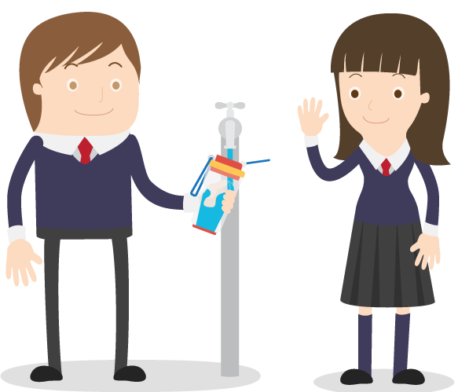
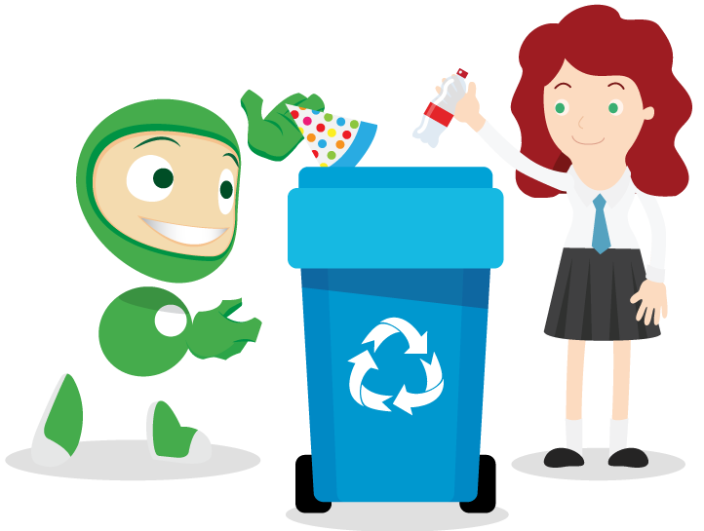
Let’s try to save our planet!
Learn more at ecoworld.org.uk

